Slide 1


jQuery
SAMPATH KUMAR BINGI
February, 2018

Slide 2
AGENDA
What is jQuery ?
HTML5 APIs
HTML5 Drag and Drop
HTML5 graphics
HTML5 Web storage
Web SQL database
Best practices

Slide 3
What is jQuery ?
jQuery is a lightweight, "write less, do more", JavaScript library.
Simplifies the task of creating highly responsive web pages.
jQuery also simplifies a lot of the complicated things from JavaScript, like AJAX calls and DOM manipulation.

Slide 4
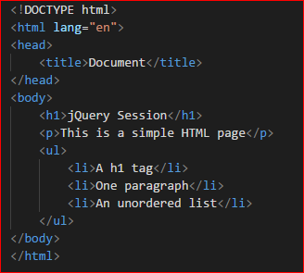
Document Object Model
<html>
<head>
<body>
<title>
<h1>
<p>
<ul>
<li>
<li>
<li>

Slide 5

Getting Started
Enable jQuery in your page by including jQuery library references or CDN
https://code.jquery.com/jquery-3.2.1.min.js
https://ajax.googleapis.com/ajax/libs/jquery/3.2.1/jquery.min.js
https://ajax.aspnetcdn.com/ajax/jQuery/jquery-3.2.1.min.js
Use $(document).ready() to detect when a page has loaded and is ready to use

Slide 6
jQuery Selectors
Tag Name
$(“tagName”) - $(“div”), $(“a”), $(“p”), …
Tag ID
$(“#tagId”) - $(“#name”), $(“address”)
Tag Class
$(“.className”) - $(“.comment”), $(“.code”)
Combined selectors
$(“tagName, .className”), $(“tagName, .className, #tagId”)
$(“h1, .mainTitle”), $(“h1, .mainTitle, #firstHeading”)
http://codylindley.com/jqueryselectors/
Index filters
Conditional filters – Form filters
Relationship filters – Content filters
Attribute filters
Retrieve, Set and Remove attributes
Class, HTML, Text, Value – Functions
Traversing
Events
Notes:
https://api.jquery.com/

Slide 7

.each()
.each(function(index,element)) is used to iterate through jQuery objects
$.each(collection,function(index,value){ /*code block*/ });
Iterates through each object in collection.
Avoid using selectors and DOM manipulations in .each() function, rather create a string with local variables and update the DOM outside the .each() function

Slide 8
Events
jQuery provides a cross-browser event model that works in all browsers
live(), delegate() and on() allow new DOM elements to automatically be attached to an event handler
.delegate() is added to overcome the disadvantage on .live()
.on(eventType,handler(eventObject)) attaches a handler to an event for the selected element(s)
.off(event) is used to remove a handler previously bound to an element
Notes:
https://j11y.io/jquery/
https://api.jquery.com/category/events/ -- jquery shortcut events
InLine onClick event
Handle events the old-fashioned way
jQuery shortcut events
WireEvents() – Click event
WireEvents() - Change event
WireEvents() – mouse events
WireEvents() – hover events
live() removed in jQuery 1.9, die() used to remove the events
Delegate() added as an advantage to live()
.delegate() works for dynamically added elements, undelegated() is used to remove the delegate events
On() added in jquery 1.7
$(‘#test’).off() removes all events, $(‘test’).off(‘click’) removes specific (click) event

Slide 9
.live() vs .delegate()
.live() | .delegate()
The document object handles events by default | A context object handles events by default rather than the document object
Works even when new objects are added into the DOM | Works even when new objects are added in to the DOM
$(‘.someClass’).live(‘click’,somefunction); | $(‘#div’).delegate(‘.someClass’,’click’,someFunction);
Scans for all elements having someClass and triggers the event, which is performance impact | Scans elements specific to the context object (#div)
Stop live event handling using die() | Stop delegate event handling using undelegated()
Notes:
https://j11y.io/jquery/
https://api.jquery.com/category/events/ -- jquery shortcut events
InLine onClick event
Handle events the old-fashioned way
jQuery shortcut events
WireEvents() – Click event
WireEvents() - Change event
WireEvents() – mouse events
WireEvents() – hover events
live() removed in jQuery 1.9, die() used to remove the events
Delegate() added as an advantage to live()
.delegate() works for dynamically added elements, undelegated() is used to remove the delegate events
On() added in jquery 1.7
$(‘#test’).off() removes all events, $(‘test’).off(‘click’) removes specific (click) event

Slide 10
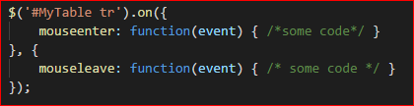
.on()
The .on() function can be used in place of live() and delegate()
Works when new objects are added into the DOM
$(‘#MyTable tbody’).on(‘click’, ’tr’, function(event) { /*some code*/ } );
.on() allows multiple events to be bound to one or more elements
Multiple events and handlers can be defined in on() using a map:
Notes:
https://j11y.io/jquery/
https://api.jquery.com/category/events/ -- jquery shortcut events
InLine onClick event
Handle events the old-fashioned way
jQuery shortcut events
WireEvents() – Click event
WireEvents() - Change event
WireEvents() – mouse events
WireEvents() – hover events
live() removed in jQuery 1.9, die() used to remove the events
Delegate() added as an advantage to live()
.delegate() works for dynamically added elements, undelegated() is used to remove the delegate events
On() added in jquery 1.7
$(‘#test’).off() removes all events, $(‘test’).off(‘click’) removes specific (click) event

Slide 11
jQuery Ajax
Allows parts of a page to be updated
Cross-Browser support, Simple API
Get and Post methods supported
Load JSON, XML, HTML or even scripts
jQuery ajax function works with REST APIs, Web services and more
jQuery Ajax function
.load() : Loads HTML data from the server
$.get() and $.post() : Get raw data from the server
$.getJSON() : Get/Post and return JSON
$.ajax() : Provides core functionality

Slide 12
jQuery plugins
Image Plugins
Filters, Overlays, Tooltips, Zoom, Lazy load, Rounded corners , Slideshows
Forms plugins
Auto Complete, Auto tab, jQuery UI, Masked Input, Max length, Validation, Wizard
Social Plugins
Youtube, Twitter, Facebook
Other Plugins
Activity Indicator, Countdown timer, List navigation, Notifications, popups, Tooltips

Slide 13
Useful Tips and Tricks

Slide 14
Best Practices
Avoid using selectors and DOM manipulations in $.each() function, rather create a string with local variables and update the DOM outside the $.each() function

Slide 15
VERSIONS OF HTML
YEAR | VERSION | NEW FEATURES
1991 | HTML
1993 | HTML+
1995 | HTML 2.0
1997 | HTML 3.2
1999 | HTML 4.01 | Strict, Transitional and Frameset are introduced
2012 | HTML 5 | Video and audio elements, 2D/3D graphics, Local storage and Local SQL database

Slide 16
DIFFERENCE BETWEEN HTML4 AND 5
HTML4 | HTML5
HTML4 uses common structures like headers, footers. | HTML5 uses new structures such as drag, drop and much more.
HTML4 cannot embed video or audio directly and makes use of flash player for it. | HTML5 can contain embedded video and audio without using flash player.
HTML4 cannot handle inaccurate syntax. | HTML5 is capable of handling inaccurate syntax.
HTML4 has traditional API’s which does not include canvas and content editable API’s | HTML5 introduced many new API’s which facilitate flexibility of web pages.
In HTML4, local storage is not possible and tags that can handle only one dimension are present. | In HTML5, new tags and new features like local storage and local SQL database are enhanced.

Slide 17
NEW ELEMENTS IN HTML5
<article>
<aside>
<audio>
<canvas>
<command>
<datalist>
<details>
<embed>
<figcaption>
<figure>
<footer>
<header>
<hgroup>
<keygen>
<mark>
<meter>
<nav>
<output>
<progress>
<rp>
<rt>
<ruby>
<section>
<source>
<summary>
<time>
<video>
<wbr>

Slide 18
HTML5 SEMANTIC ELEMENTS
<header>
<nav>
<section>
<article>
<aside>
<figcaption>
<figure>
<address>
<footer>
<header>
<nav>
<section>
<aside>
<article>
<footer>

Slide 19
NEW INPUT TYPES AND ATTRIBUTES
TYPES
ATTRIBUTES
Color
Date
Datetime
Email
Month
Number
Range
Search
Tel
Time
Week
Step
Pattern
Placeholder
Min and max
Multiple
Required
List
Formtarget

Slide 20

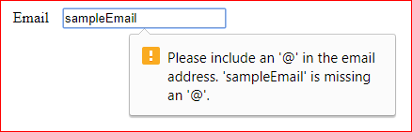
NEW INPUT TYPES AND ATTRIBUTES
Number
Email

Slide 21
HTML5 MEDIA ELEMENTS
ELEMENT | DESCRIPTION
Audio | Audio element is used to define or create a music element in your simple HTML page.
Video | Video element creates a video element in your HTML page.
Track | This element helps to define tracks or we can say simple sectors for the <audio> and <video> elements.
Source | The Source element must be used in <audio> and <video> elements to do the control property and structure of the tracks.
Embed | It is used for defining the containers for the external applications or we can say plug-ins for the Applications.

Slide 22
HTML5 AUDIO TAG
New element allows to deliver audio files directly through the browser, without any plug-ins
Attributes | DESCRIPTION
Autobuffer | This Boolean attribute indicates whether or not the browser should begin buffering audio right away.
Autoplay | This is Boolean attribute indicate whether or not the file should start playing audio as soon as it can.
Loop | This Boolean attribute indicates whether or not apply repetition on playing audio.
Src | This attribute is used to specify the URL (location of the audio file) of the audio to show.
Controls | This Boolean attribute specify whether or not the browser should display audio controls (such as play/pause, volume and seek).

Slide 23

HTML5 AUDIO TAG

Slide 24
HTML5 VIDEO TAG
New element allows to deliver video files directly through the browser, without any plug-ins
Attributes | DESCRIPTION
Autobuffer | Video will start buffering automatically.
Autoplay | Video will start playing automatically.
Loop | Video automatically start over again when done.
Src | Address of the video
Controls | To show/hide the controls
Poster | URL(address) of the image

Slide 25

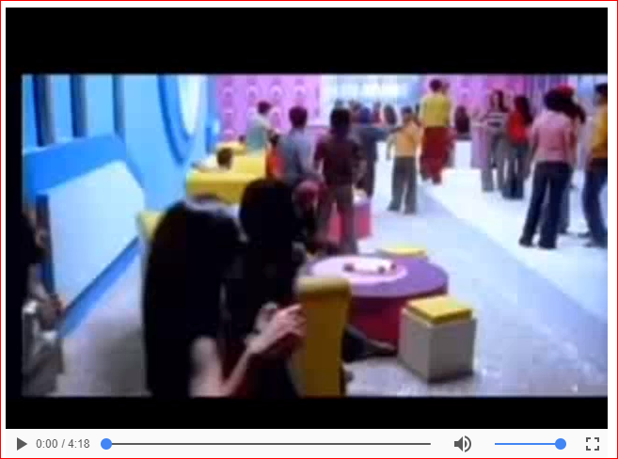
HTML5 VIDEO TAG

Slide 26
HTML5 APIs
Web Workers API
Server-sent Events API
WebSocket API
Cross-document Messaging API
Drawing
Audio/Video
Drag and drop
Autofocus
Editable
Client-side storage
Geolocation

Slide 27
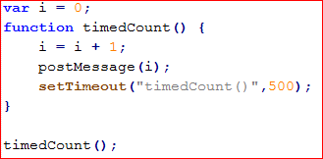
WEB WORKER
A web worker is a javascript that runs in the background, without effecting the performance of the page
Create a Web Worker file
Create a Web Worker object
Terminate a Web Worker
Reuse the Web Worker
Web worker file
(Demo_worker.js)

Slide 28
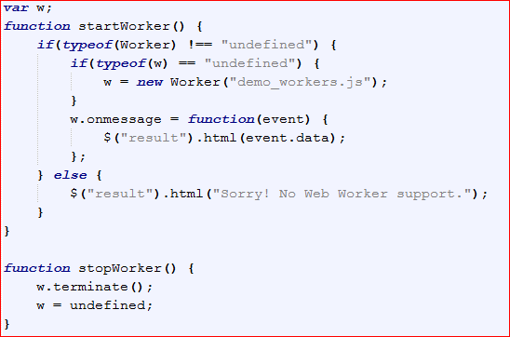
WEB WORKER
Web worker object
Terminate web worker
Reuse web worker

Slide 29
HTML5 DRAG AND DROP
Before this feature we could do drag and drop using jQuery or other Api’s
HTML5 has its own drag and drop feature
Drag and Drop API came with seven new events to track a drag and drop
EVENTS | DESCRIPTION
dragstart | Triggered when dragging a draggable element
drag | Triggered when the draggable element is moved
dragend | Triggered when the drag and drop operation ends
dragenter | Triggered when the draggable element is dragged over the target element
dragleave | Triggered when the user’s cursor leaves the target element while dragging
dragover | Triggered when a draggable object is moved inside an element
drop | Triggered when a draggable object is dropped

Slide 30

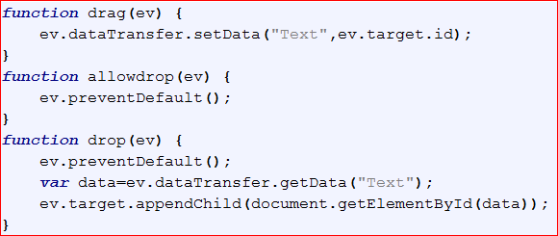
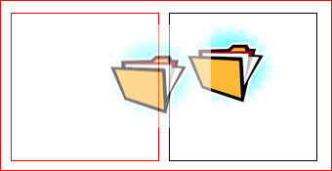
HTML5 DRAG AND DROP

Slide 31
HTML5 GRAPHICS
SCALABLE VECTOR GRAPHICS (SVG)
HTML tag <svg> is a container for SVG graphics
SVG is used for drawing paths, circles, boxes, text and graphic images
CANVAS
It is a rectangle area on HTML page for drawing graphics on the fly via javascript
The default size of canvas is 300px X 150px (width X height)
HTML tag <canvas> is a container for Canvas graphics

Slide 32
SCALABLE VECTOR GRAPHICS (SVG) IN HTML5
ELEMENT | DESCRIPTION
Line | Create simple line
Circle | Creates circle
Rect | Creates Rectangle
Ellipse | Creates Ellipse
Polygon | Creates Polygon
Polyline | Creates Multiline Shape
Path | Creates Arbitrary Path
Text | Creates Text

Slide 33
SCALABLE VECTOR GRAPHICS (SVG) IN HTML5
Path element is used to draw the complex drawings with support of some commands
COMMAND | DESCRIPTION
M | Move to
L | Line to
H | Horizontal line to
V | Vertical line to
C | Curve to
S | Smooth curve to
Q | Quadratic Bezier curve to
T | Smooth quadratic Bezier curve to
A | Elliptical arc to
Z | Close path to

Slide 34

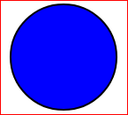


SCALABLE VECTOR GRAPHICS (SVG) IN HTML5

Slide 35
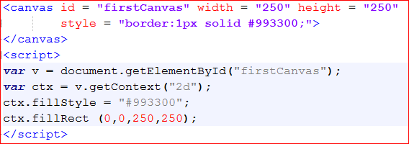

CANVAS IN HTML5

Slide 36
DIFFERENCE BETWEEN CANVAS AND SVG
CANVAS | SVG
Pixel based, Essentially and image element with a drawing API | Object Model based, Elements are similar to HTML elements
Visual presentation created and modified programmatically through script | Visual presentation created with markup and modified by css
Canvas draws 2D graphics on fly. | SVG defines the graphics in XML format
Resolution dependent | Resolution independent
Prodecural | Declarative

Slide 37
HTML5 WEB STORAGE
IT is a DOM storage in a way to preserve state on either the client or server which makes it much easier to work against the stateless nature of HTTP
It can store 5 to 10 MB data. That is far more than what cookies have
Web storage data is never transferred with HTTP request, so it increases the performance of the application
Data is stored as a simple string, manipulation is needed to store objects of different types such as Booleans, objects, ints and floats
It has a default 5MB limit, more storage can be allowed by the user, if required
Storage can be slow with the complex sets of data.

Slide 38
HTML5 WEB STORAGE
STORAGE METHODS | DESCRIPTION
setItem(key,value) | Adds a key/value pair to sessionStorage object.
getItem(key) | Retrieves the value for a given key
clear() | Removes all key/value pairs for the sessionStorage object
removeItem(key) | Removes a key/value pair from the sessionStorage object
key(n) | Retrieves the value for a key

Slide 39
HTML5 WEB STORAGE
STORAGE PROPERTIES
Constructor – Returns a reference to the constructor of an object
Length – Retrieves the length of the key/value list
RemainingSpace – Retrieves the remaining memory space, in bytes, for the storage object
STORAGE TYPES
LocalStorage
SessionStorage

Slide 40
HTML5 WEB STORAGE
LOCAL STORAGE
Long term data persistence
The local storage object spans multiple windows and persists beyond the current session
Values put into localStorage are shared across all windows from the same origin
Data is stored on the client. Behaving similarly to cookies, values persist beyond when the browser’s session ends.
SESSION STORAGE
Short term data persistence
Once the browser’s session ends (window/tab closed), sessionStorage ends.
Values put inot sessionStorage are only visible in the window/tab that created them
Data is stored on the server

Slide 41
HTML5 WEB STORAGE
LOCAL STORAGE
Browser Window 1
Browser Window 2
Long term data persistence
The local storage object spans multiple windows and persists beyond the current session
Values put into localStorage are shared across all windows from the same origin
Data is stored on the client. Behaving similarly to cookies, values persist beyond when the browser’s session ends.
Tab 1
Tab 2
Tab 1
Tab 2
Local Storage

Slide 42
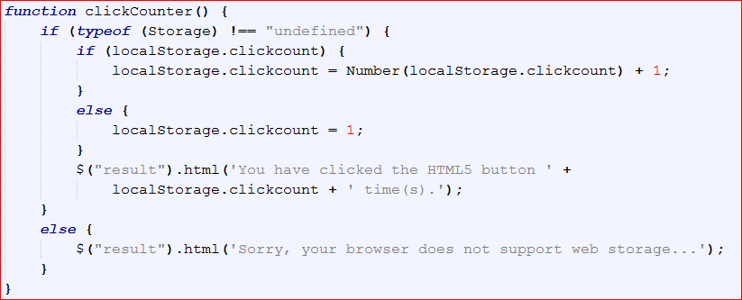
HTML5 WEB STORAGE
LOCAL STORAGE

Slide 43
HTML5 WEB STORAGE
SESSION STORAGE
Short term data persistence
Once the browser’s session ends (window/tab closed), sessionStorage ends.
Values put inot sessionStorage are only visible in the window/tab that created them
Data is stored on the server
Browser Window
Tab 1
Tab 2
Session Storage

Slide 44
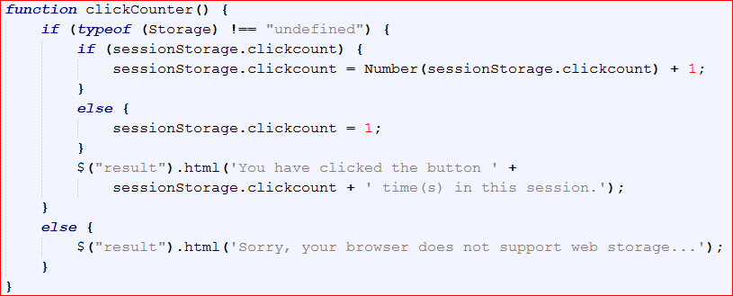
HTML5 WEB STORAGE
SESSION STORAGE

Slide 45
WEB SQL DATABASE
Web SQL is used to manipulate a client-side database
It stores data at the client side
Do not store sensitive information
Methods of Web SQL
openDatabase
Transaction
executeSql

Slide 46
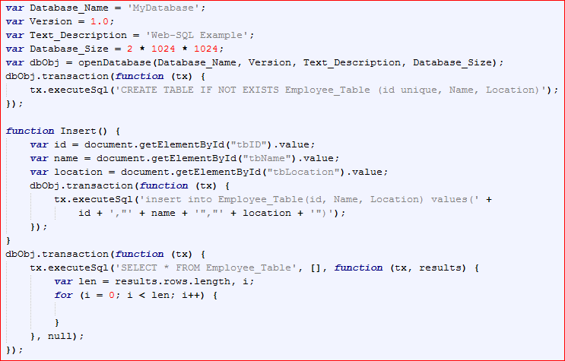
WEB SQL DATABASE

Slide 47
BEST PRACTICES
Declare the correct doctype
Always use lower case html tags
Descriptive Meta tags
Avoid Inline styles
Have CSS links in HEAD tags
Place Java Script at end of the HTML file before HTML closing tag
Use CSS transitions in place of Javascript implementations
Use alt attribute for img tags
Use Semantic elements to design the layout

Slide 48
BEST PRACTICES
Simplify your forms
Use <pre> and <code> tags.
Minify CSS and Javascript files
View Source in browser
<b> and <i> has different representation in HTML5
Use <strong> for bold and <em> for italic instead

Slide 49
Thank You

